Slide 1
Notes:
Chapter Five
Estimating Project Times and Costs

Slide 2
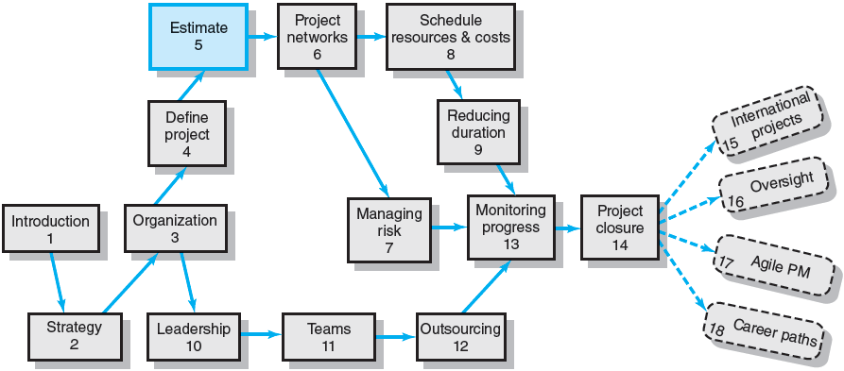
Where We Are Now
Notes:
Where Are We Now
Chapter Five focuses on estimating, the process of forecasting or approximating the time and cost of completing project deliverables. Given the urgency to start work on the project, managers sometimes minimize or avoid the effort to follow through on estimating project time and cost. However, reliable cost, time, and budget estimates are the lifeline for control; they serve as the standard for comparison of actual and plan performance throughout the life of the project.

Slide 3
Estimating Projects
Estimating
The process of forecasting or approximating the time and cost of completing project deliverables.
The task of balancing expectations of stakeholders and need for control while the project is implemented.
Types of Estimates
Top-down (macro) estimates: analogy, group consensus, or mathematical relationships
Bottom-up (micro) estimates: estimates of elements of the work breakdown structure
Notes:
Estimating is the process of forecasting or approximating the time and cost of completing project deliverables. Estimating processes are classified as top-down and bottom-up. Senior management’s top-down estimates are derived from analogous activities, group consensus, and mathematical relationships. Bottom-up estimates are performed by the people who base their estimates on elements found in the work breakdown structure.

Slide 4
Why Estimating Time and Cost Are Important
To support good decisions.
To schedule work.
To determine how long the project should take and its cost.
To determine whether the project is worth doing.
To develop cash flow needs.
To determine how well the project is progressing.
To develop time-phased budgets and establish the project baseline.
EXHIBIT 5.1
Notes:
Exhibit 5.1 summarizes key and important reasons to make the effort and incur the cost of estimating for a project:
To support good decisions.
To schedule work.
To determine how long the project should take and its cost.
To determine whether the project is worth doing.
To develop cash flow needs.
To determine how well the project is progressing.
To develop time-phased budgets and establish the project baseline.

Slide 5
Factors Influencing the Quality of Estimates
Planning Horizon
Other (Nonproject) Factors
Project Duration
Quality of Estimates
Organization Culture
People
Padding Estimates
Project Structure and Organization
Notes:
Factors related to the uniqueness of the project strongly influence the accuracy of estimates. Both internal and external factors need to be considered to improve the quality of estimates for project times and costs. Those factors include the planning horizon, project duration, people, project structure and organization, padding estimates, organization culture, and other nonproject factors.

Slide 6
Developing Work Package Estimates
Use people familiar with the tasks
Include a risk assessment
Use several people to make estimates
Preparing Initial Estimates
Make no allowance for contingencies
Assume normal conditions
Assume tasks are independent
Use consistent time units
Notes:
Initial work package estimates must be as accurate as possible since poor estimates are a major contributor to project failures. This slide graphically presents seven guidelines that managers can use to develop useful work packages estimates. Project managers should do the following:
Have people familiar with the tasks make the estimate.
Use several people to make estimates.
Base estimates on normal conditions, efficient methods, and a normal level of resources.
Use consistent time units in estimating task times.
Treat each task as independent, don’t aggregate.
Do not make allowances for contingencies.
Add a risk assessment to avoid surprises to stakeholders.

Slide 7
Estimating Guidelines for Times, Costs, and Resources
Have people familiar with the tasks make the estimate.
Use several people to make estimates.
Base estimates on normal conditions, efficient methods, and a normal level of resources.
Use consistent time units in estimating task times.
Treat each task as independent, don’t aggregate.
Do not make allowances for contingencies.
Add a risk assessment to avoid surprises to stakeholders.
Notes:
This slide lists seven guidelines that project managers can use in the development of work package estimates. The guidelines are:
Have people familiar with the tasks make the estimate.
Use several people to make estimates.
Base estimates on normal conditions, efficient methods, and a normal level of resources.
Use consistent time units in estimating task times.
Treat each task as independent, don’t aggregate.
Do not make allowances for contingencies.
Add a risk assessment to avoid surprises to stakeholders.

Slide 8
Top-Down versus Bottom-Up Estimating
Top-Down Estimates
Are usually derived from someone who uses experience and/or information to determine the project duration and total cost.
Are made by top managers who have little knowledge of the processes used to complete the project.
Bottom-Up Approach
Can serve as a check on cost elements in the WBS by rolling up the work packages and associated cost accounts to major deliverables at the work package level.
Notes:
Top-down estimates are derived from someone who uses experience and/or information to determine the project duration and total cost. They are also may be made by top managers who have little knowledge of the processes used to complete the project.
The bottom-up approach serves as a check on cost elements in the WBS by rolling up the work packages and associated cost accounts to major deliverables at the work package level.

Slide 9
Top-Down versus Bottom-Up Estimating
Conditions for Preferring Top-Down or Bottom-up Time and Cost Estimates
Top-down Bottom-up Condition Estimates Estimates
Strategic decision making X
Cost and time important X
High uncertainty X
Internal, small project X
Fixed-price contract X
Customer wants details X
Unstable scope X
TABLE 5.1
Notes:
There are sound reasons for using both top-down or bottom-up estimates. Table 5.1 depicts conditions that suggest when one approach is preferred over another. Top down estimates are preferred when estimates involve strategic decision making, high uncertainty, small internal projects, and projects with unstable scope. Bottom-up estimates are more appropriate when cost and time factors are important, the project will be subject to a fixed-price contract, and when the customer requires a detailed work package.

Slide 10
Estimating Projects: Preferred Approach
Make rough top-down estimates.
Develop the WBS/OBS.
Make bottom-up estimates.
Develop schedules and budgets.
Reconcile differences between top-down and bottom-up estimates
Notes:
The preferred approach to preparing work package estimates combines the top-down and bottom-up estimation methods to produce an estimate that recognizes the necessity and benefits of viewing the project from both approaches. Project managers can do the following:
Make rough top-down estimates.
Develop the WBS/OBS.
Make bottom-up estimates.
Develop schedules and budgets.
Reconcile differences between top-down and bottom-up estimates

Slide 11
Top-Down Approaches for Estimating Project Times and Costs
Consensus methods
Uses pooled experience of senior or middle managers to estimate the total project duration and cost- meeting and discussion to reach a decision to their best guess.-e.g Delphi Method- rough estimate
Ratio methods
Use ratios or a common experiential factor (square feet) or parametric factor to estimate
Apportion method
Apportion methods that incorporate historical data about standardized work when a current project closely follows past projects in features and costs
Project Estimate Times Costs
Notes:
At the strategic level top-down estimating methods are used to evaluate a project proposal due to the initial lack of available information or when some WBS details have not yet been clearly defined. Those methods include:
Consensus methods that rely on the pooled experience of senior and/or middle managers to estimate the total project duration and cost
Ratio methods that use a common experiential factor to arrive at an initial duration and cost estimate for the project.
Apportion methods that incorporate historical data about standardized work when a current project closely follows past projects in features and costs.
Function point methods for software and system projects use weighted macro variables to develop labor and effort cost estimates.
Learning curves use ratio associated with the pattern of efficiency improvement that comes for repeating task activities to develop time and cost estimates for repetitive tasks.

Slide 12
Cont.
Function point methods for software and system projects
Function point methods for software and system projects use weighted macro variables to develop labor and effort cost estimates.
Learning curves
Learning curves use ratio associated with the pattern of efficiency improvement that comes for repeating task activities to develop time and cost estimates for repetitive tasks.-time to perform a task improves with repetition.
Each time the output quantity doubles , the unit labor hours are reduced at a constant rate.

Slide 13
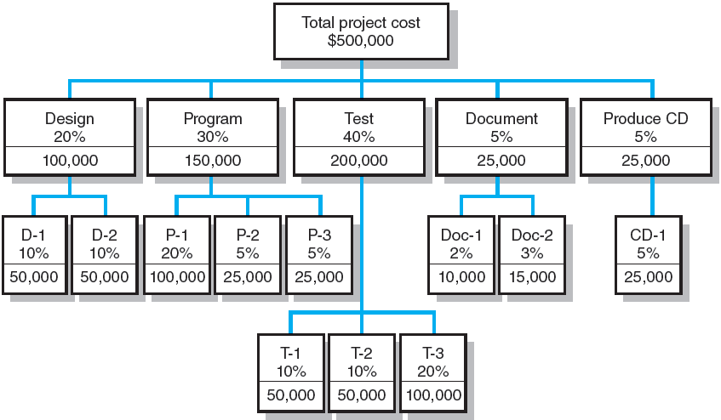
Apportion Method of Allocating Project Costs Using the Work Breakdown Structure
FIGURE 5.1
Notes:
Figure 5.1 presents an example of the apportion method. The total project cost is estimated, using a top-down estimate, to be $500,000, all other costs are apportioned as a percentage of the total cost. For example, the costs apportioned to the “Document” deliverable are 5 percent of the total, or $25,000. The subdeliverables “Doc-1 and Doc-2” are allocated 2 and 3 percent of the total—$10,000 and $15,000, respectively.

Slide 14
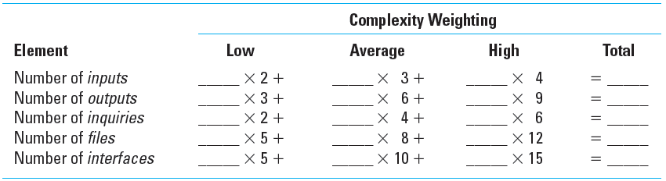
Simplified Basic Function Point Count Process for a Prospective Project or Deliverable
TABLE 5.2
Notes:
Table 5.2 shows a blank Function Point Count template into which quantity estimates of project function points can be insert to develop an estimate of labor effort and cost for a project.

Slide 15
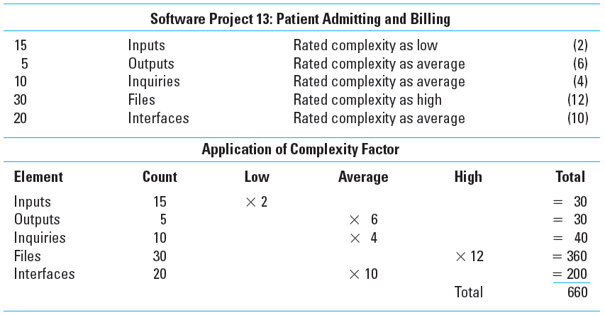
Example: Function Point Count Method
TABLE 5.3
Notes:
Table 5.3 shows a completed Function Point Count template into which quantity estimates of project function points have been inserted to develop an estimate of labor effort and cost for a project.

Slide 16
Bottom-Up Approaches for Estimating Project Times and Costs
Template methods
Template methods that rely on the similarity of current projects to past projects to develop initial estimates of costs as a starting point for the new project.
Parametric procedures applied to specific tasks
Parametric procedures that use industry-standard factors applied to specific tasks to create accurate estimates of labor effort and costs.
Notes:
Project managers prefer to use various bottom-up approaches to develop estimates project times and costs because micro estimating methods are usually more accurate than the macro methods of top-down approaches. Commonly-used bottom-up approaches include:
Template methods that rely on the similarity of current projects to past projects to develop initial estimates of costs as a starting point for the new project.
Parametric procedures that use industry-standard factors applied to specific tasks to create accurate estimates of labor effort and costs.
Range estimates that use group estimates when WBS work packages have significant uncertainty associated with their time or cost to complete.
Phase estimating is used to refine top-down estimates as phases of the project are implemented when an unusual amount of uncertainty surrounds a project and it is impractical to estimate times and costs for the entire project.

Slide 17
Range estimates for the WBS work packages
Range estimates that use group estimates when WBS work packages have significant uncertainty associated with their time or cost to complete. Ask for 3 estimates (low, average and high)
Phase estimating: A hybrid
Phase estimating is used to refine top-down estimates as phases of the project are implemented when an unusual amount of uncertainty surrounds a project and it is impractical to estimate times and costs for the entire project. (aerospace or IT projects)
Uses a two-estimate system system over the life of the project.

Slide 18
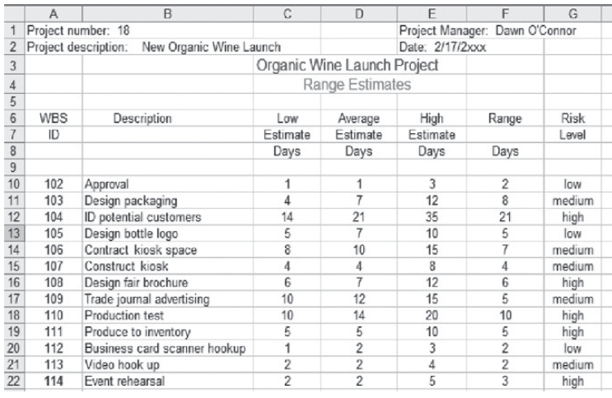
Range Estimating Template
FIGURE 5.2
Notes:
Figure 5.2 presents a range estimating template using three time estimates for work packages developed by a cross functional group(s) of project stakeholders. The group estimates show the low, average, and high time estimate for each work package.
The Risk Level column is the group’s assessment that the actual time will be very close to the estimate based on the group’s evaluation of factors that might impact the average time estimate.
The group feels there is a high chance that packages 104, 108, 110, 111, and 114 t may vary from their expected times. The group has assessed the risk of time variation in work packages 102, 105 and 112 as low.

Slide 19
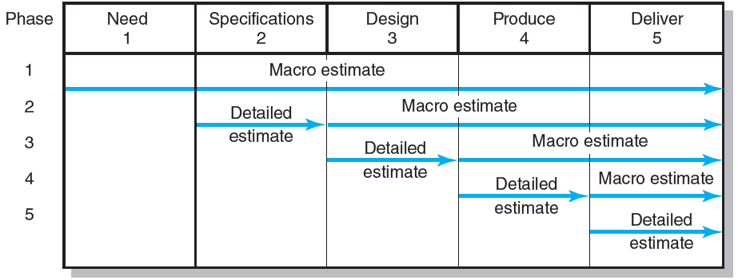
Phase Estimating over Product Life Cycle
FIGURE 5.3
Notes:
Figure 5.3 depicts the five phases of a hypothetical project and the creation and progressive refinement of estimates over the project’s life cycle.

Slide 20
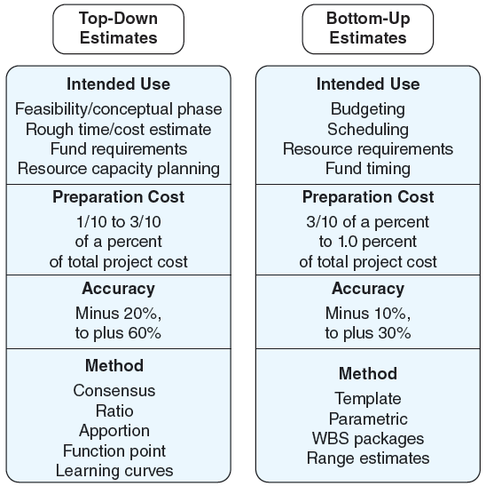
Top-Down and Bottom-Up Estimates
FIGURE 5.4
Notes:
Figure 5.4 presents a side-by-side summary of the costs, methods, uses, overall estimate accuracy, and different methods of top-down and bottom-up estimates.

Slide 21
Level of Detail
Level of detail is different for different levels of management.
Level of detail in the WBS varies with the complexity of the project, the need for control the project size, cost , duration and other factors. –delicate balancing is needed (built-in flexibility)
Excessive detail is costly.
Fosters a focus on departmental outcomes
Creates unproductive paperwork
Insufficient detail is costly.
Lack of focus on goals
Wasted effort on nonessential activities
Notes:
Level of detail is different for different levels of management, however, at any level the detail should be no more than is necessary and sufficient. The level of detail in the WBS varies with the complexity of the project; the need for control; the project size, cost, duration; and other factors. Excessive detail also means more unproductive paperwork. If the level of detail is not adequate, an organization unit may find the structure falls short of meeting its needs and hampers its achievement of goals.

Slide 22
Types of Costs
Direct Costs
Costs that are clearly chargeable to a specific work package.
Labor, materials, equipment, and other
Direct (Project) Overhead Costs
Costs incurred that are directly tied to an identifiable project deliverable or work package.
Salary, rents, supplies, specialized machinery
General and Administrative Overhead Costs
Organization costs indirectly linked to a specific package that are apportioned to the project
Notes:
The typical types of costs found in a project fall into three categories:
Direct costs for labor, materials, equipment, and other items that are clearly chargeable to a specific work package.
Direct (project) overhead costs for salary, rents, supplies, specialized machinery that are directly tied to an identifiable project deliverable or work package.
General and administrative overhead costs represent organization costs indirectly linked to a specific package that are apportioned to the project.

Slide 23
Contract Bid Summary Costs
Direct costs | $80,000
Direct overhead | $20,000
Total direct costs | $100,000
G&A overhead (20%) | $20,000
Total costs | $120,000
Profit (20%) | $24,000
Total bid | $144,000
FIGURE 5.5
Notes:
Figure 5.5 presents a breakdown of costs for a proposed contract bid that shows direct costs , direct overhead costs, and general administrative costs.

Slide 24
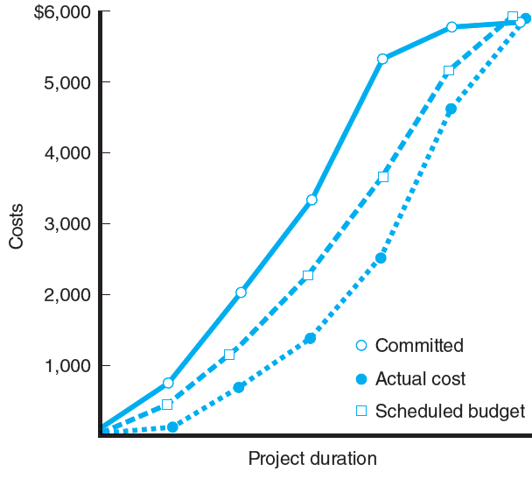
Three Views of Cost
FIGURE 5.6
Notes:
Figure 5.6 depicts how the different perceptions of costs and budgets vary depending on their users. Each stakeholder has a different viewpoint of the costs and respective timings and the importance of variances in these costs.

Slide 25
Refining Estimates
Reasons for Adjusting Estimates
Interaction costs are hidden in estimates.
Normal conditions do not apply.
Things go wrong on projects.
Changes in project scope and plans.
Adjusting Estimates
Time and cost estimates of specific activities are adjusted as the risks, resources, and situation particulars become more clearly defined.
Notes:
Experience with projects tells project managers that actual work times and costs do not always agree with the original work package–based estimates of their respective projects. Adjustments to estimates are necessary for the following reasons:
Interaction costs are hidden in estimates.
Normal conditions do not apply.
Things go wrong on projects.
Changes in project scope and plans.

Slide 26
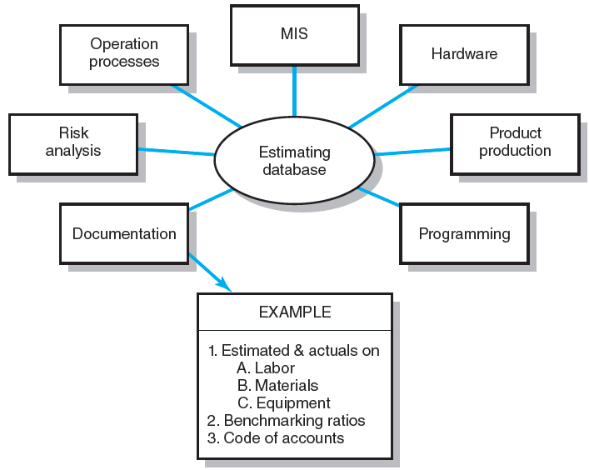
Estimating Database Templates
shows the different information sources that contribute to the estimating knowledge database of past project estimates and actuals for use by estimating professionals in an organization. Information in the database is expected to improve over time as more of the experience of estimators is captured in the database.
FIGURE 5.7
Notes:
Figure 5.7 shows the different information sources that contribute to the estimating knowledge database of past project estimates and actuals for use by estimating professionals in an organization. Information in the database is expected to improve over time as more of the experience of estimators is captured in the database.

Slide 27
Key Terms
Apportionment methods
Bottom-up estimates
Contingency funds
Delphi method
Direct costs
Function points
Learning curves
Overhead costs
Padding estimates
Phase estimating
Range estimating
Ratio methods
Template method
Time and cost databases
Notes:
Apportionment methods allocate costs to a specific segment of a project by using a percentage of planned total cost.
Bottom-up estimates are detailed estimates of work packages usually made by those who are most familiar with the task (also called micro estimates).
Contingency funds set on reserve an amount of money or time to cover identified and unforeseen project risks.
Delphi technique is a group method to predict future events—e.g., time, cost.
Direct costs are project costs that re clearly charged to a specific work package—usually labor, materials, or equipment.
Function points are derived from past software projects to estimate project time and cost, given specific features of the project.
Learning curves are a mathematical curve used to predict a pattern of time reduction as a task is performed over and over.
Overhead costs are organization costs that are not directly linked to a specific project that are charged to projects to cover general expenses such as upper management, legal, market promotion, and accounting.
Padding estimates add a safety factor to a time or cost estimate to ensure the estimate is met when the project is executed.
Phase estimating is an estimating method that begins with a macro estimate for the project and then refines estimates for phases of the project as it is implemented.
Template methods use of a prepared form to develop project networks, costs, and time estimates.
Time and cost databases collect actual versus estimated times and costs of work packages over many projects that are used for estimating new project tasks and their expected possible error.

Slide 28
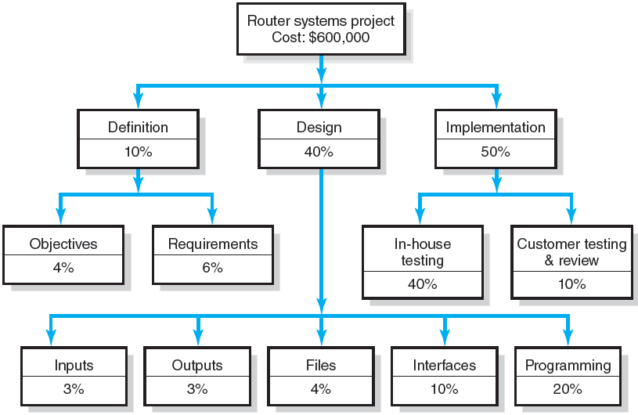
WBS Figure
Exercise 5.3
Notes:
Exercise 5.3 shows the function point complexity weighted table for the Firewall Project XT used in estimating the total function point count required for Exercise 4.

Slide 29
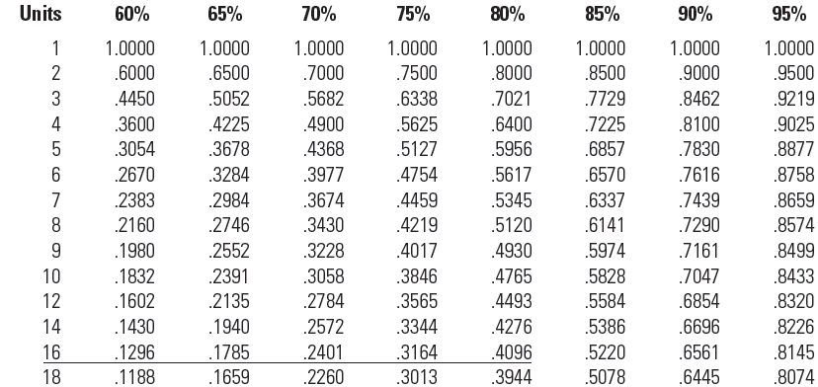
Learning Curves Unit Values
TABLE A5.1
Notes:
Table A5.1 contains the unit values for use in the calculation of the learning curve in the example in Appendix 5.1

Slide 30
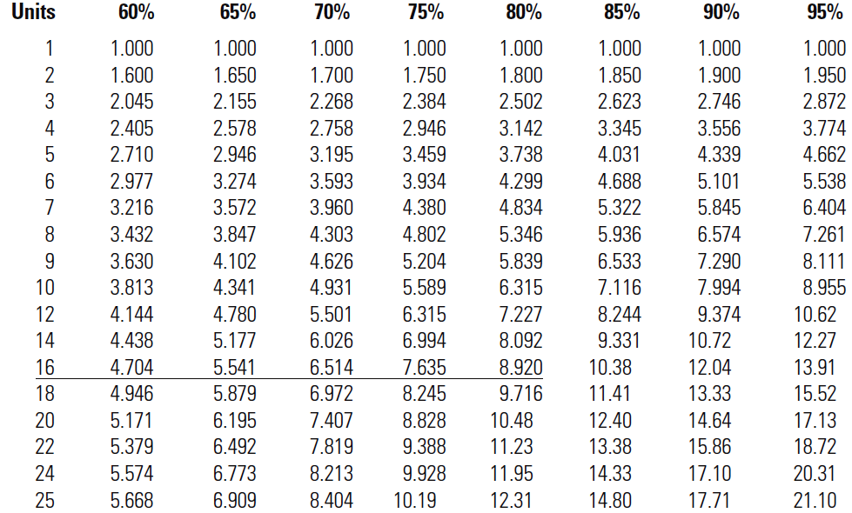
Learning Curves Cumulative Values
TABLE A5.2
Notes:
Table A5.2 contains the cumulative values for use in the calculation of the learning improvement curve in the example in Appendix 5.2

